Slide 1
Getting Started with Apache Camel via Docker in IDS
IDSA-Workshop

Slide 2

Getting Started with Apache Camel
What is this Workshop all about?
What is Apache Camel?
Open source framework used in IDS connectors for message processing
Motivation:
Support requests often focus on correct usage of Camel Routes -> Some tutorial / crash course needed
Goal:
Getting familiar with most common Camel Routes
Gain basic pragmatic knowledge about Apache Camel
Step-by-step guide to solve different guided labs

Slide 3
What Labs are available?
Starting at „Beginner“-Level
Labs involve:
Lab: Basics (processing message objects in XML Camel Routes)
Lab: Setting key material (providing SSL Contexts for IDSCP2)
Lab: File Adapter (basic reading and writing to files)
Lab: HTTP Adapter (basic web communication)

Slide 4
Important links and Info
Where to start?
ZIP-Archive with lab-instructions:
Github: IDSA-Plugfest
Chose branch „apache-camel-workshop“
Clone -> Download as Zip
https://github.com/International-Data-Spaces-Association/IDSA-Plugfest/tree/apache-camel-workshop/Apache-Camel-Workshop

Slide 5
Important links and Info
Requirements
A Linux operating system
Ubuntu as Host Operating System
Ubuntu as virtualized Operating System
Alternatively: Windows Subsystem for Linux
Docker and Docker-compose must be installed

Slide 6
Structure of All Labs
File Structure
Start:
deploy (not important, required for Trusted Connector)
etc (contains key stores to access IDS infrastructure)
example-getting-started
docker-compose.yaml (docker-compose script for launch)
example-idscp2-localloop.xml (Camel Route, to be fixed!)
Solution: (contains same structure with solved configurations

Slide 7
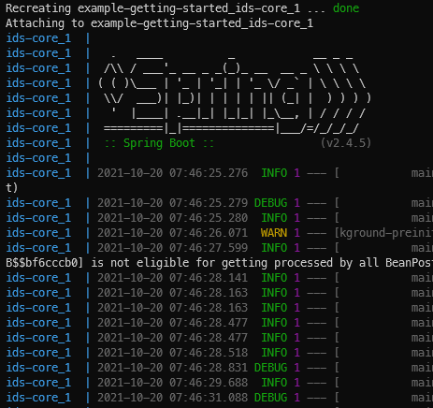
How the lab looks like
Expected Command Line Output
Change directory cd Lab1_Basics/Start/example-getting-started
Launch docker-compose docker-compose up
You sould see the screen on the right

Slide 8

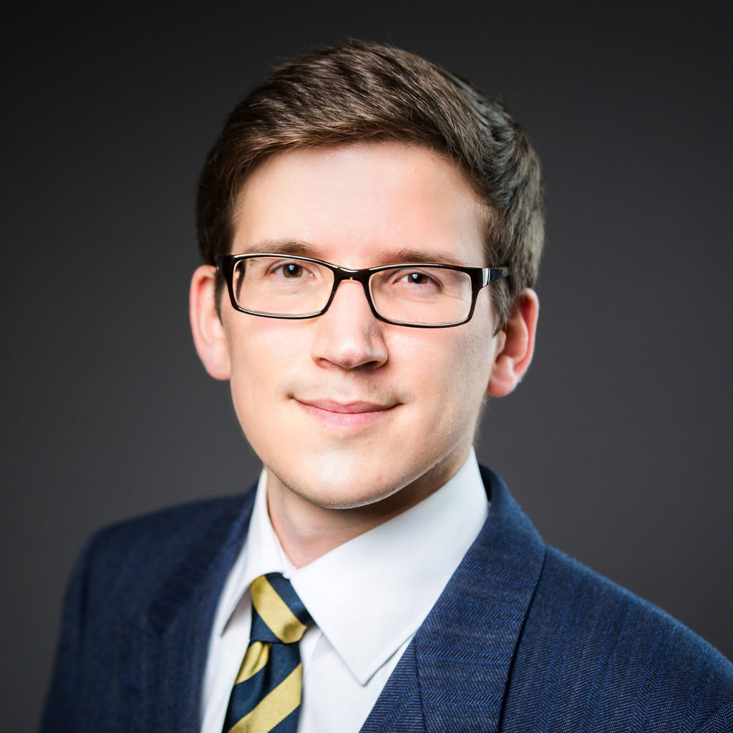



!
Join us
Hendrik Meyer zum Felde
Research Associate
Department Service & Application Security
Mail: hendrik.meyerzumfelde@aisec.fraunhofer.de
Fraunhofer AISEC
Lichtenbergstraße 11
85748 Garching near Munich | Germany
Tel. +49 89 32299 86 190
@ids_association
# internationaldataspaces
www.internationaldataspaces.org Ressource Hub – Press Area – Blog

